Slide 1
Signals and Systems
Lecturer:
Dr. Bin Xia
Dept. of Electronic Engineering
Shanghai Jiao Tong University
Chapter 6: Laplace Transform

Slide 2
Foreword of the Chapter
CT Fourier transform enables us to do a lot of things, e.g.
  Analyze frequency response of LTI systems
  Sampling
  Modulation …
Why do we need yet another transform?
  One view of Laplace Transform is as an extension of the Fourier transform to allow analysis of broader class of signals and systems
  In particular, Fourier transform cannot handle large (and important) classes of signals and unstable systems, i.e. when

Slide 3
In many applications, we do need to deal with unstable systems, e.g.
  Stabilizing an airplane or space shuttle
  …
  Instability is desired in some applications, e.g. oscillators and lasers
How do we analyze such signals/systems? Recall the eigenfunction property of LTI systems:
  e^{st} is an eigenfunction of any LTI system
  s = σ+ jω can be complex in general

Slide 4
Outline of the Chapter
6.1 (Bilateral) Laplace Transform
6.2 Properties of RoCs
6.3 Laplace Transform Properties
6.4 Inverse Laplace Transform
6.5 Analysis of LTI Systems using the LT
6.6 Unilateral Laplace Transform and Applications

Slide 5




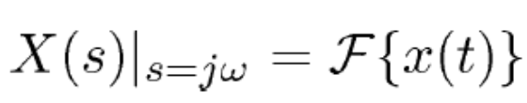
s = σ+ jω is a complex variable – Now we explore the full range of s
Basic ideas
(1)
(2) A critical issue in dealing with Laplace transform is convergence:—X(s) generally exists only for some values of s, located in what is called the region of convergence (ROC)
(3) If s= jω is in the ROC (i.e. σ= 0), then
6.1.1 The (Bilateral) Laplace Transform
absolute integrability needed
Depends only on σ not on jω
absolute integrability condition

Slide 6
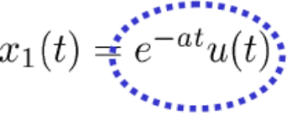
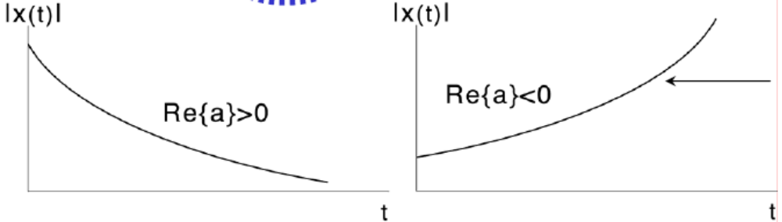
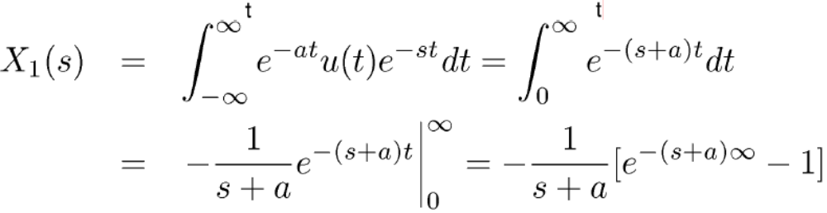
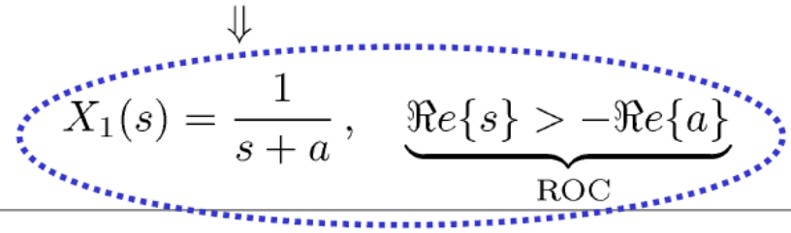
Example 1:
(a – an arbitrary real or complex number)
It converges only if Re(s+a) > 0, i.e. Re(s) > -Re(a)
Unstable:
• no Fourier Transform
• but LaplaceTransform
exists

Slide 7
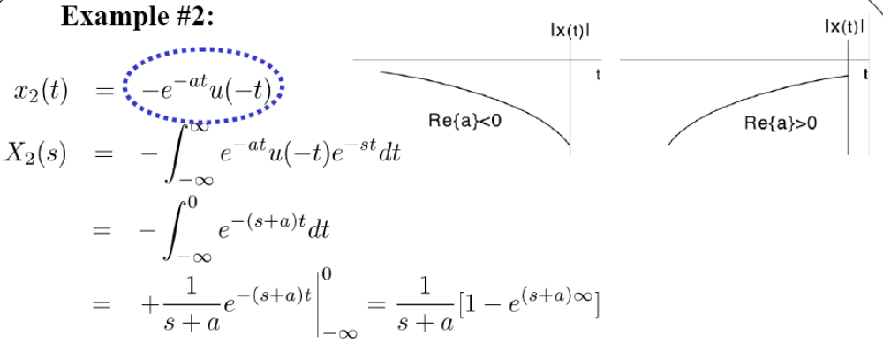
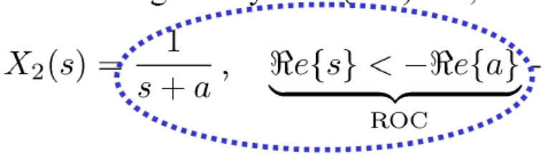
Example 2:
This converges only if Re(s+a) < 0, i.e. Re(s) < -Re(a)
Key Point (and key difference from FT): Need both X(s) and ROC to uniquely determine x(t).
No such an issue for FT.
Same as x₁(s), but different ROC

Slide 8
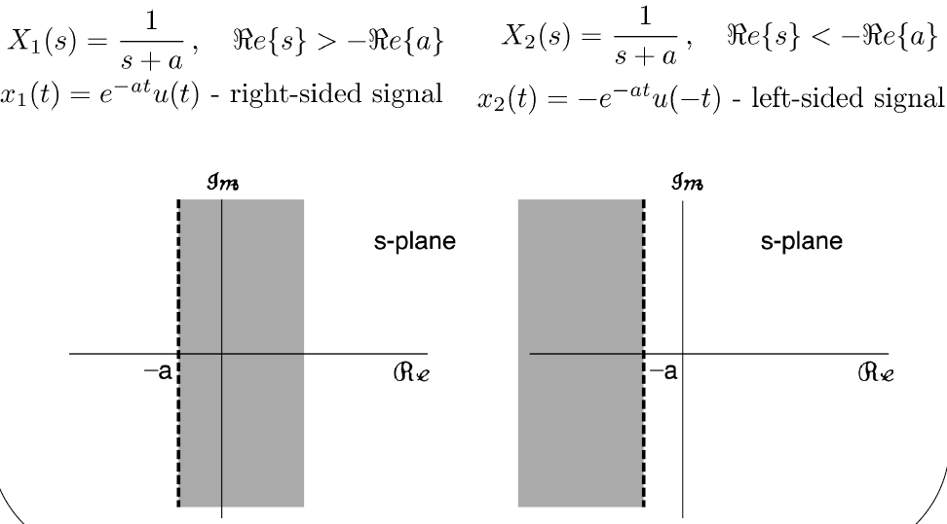
6.1.2 Graphical Visualization of the ROC
Example1 Example2

Slide 9
6.1.3 Rational Transforms
Many (but by no means all) Laplace transforms of interest to us are rational functions of s (e.g., Example 1 and 2; in general, impulse responses of LTI systems described by LCCDEs), where
X(s) = N(s)/D(s), N(s),D(s) – polynomials in s
Roots of N(s)= zeros of X(s)
Roots of D(s)= poles of X(s)
Any x(t) consisting of a linear combination of complex exponentials for t > 0 and for t < 0 (e.g., as in Example #1 and #2) has a rational Laplace transform.

Slide 10
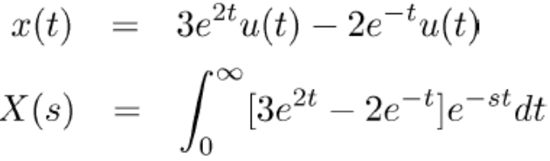
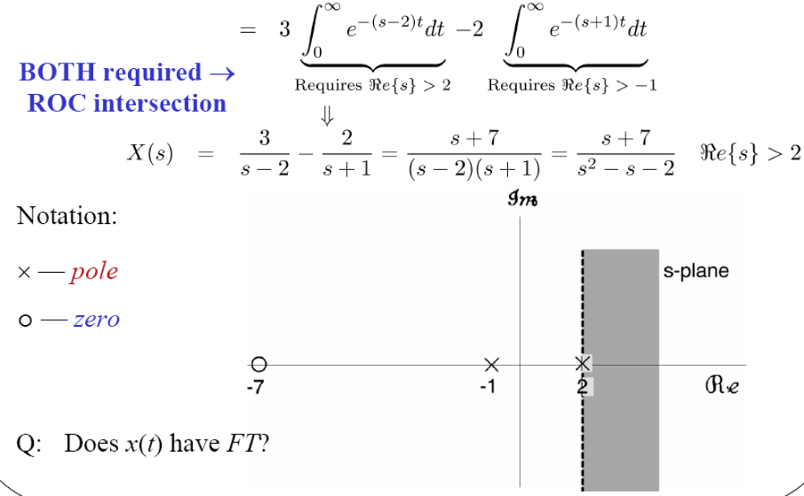
Example 3:

Slide 11
Except for a scale factor, a complete specification of a rational Laplace transform consists of the pole-zero plot of the transform, together with its RoC
About the poles or zeros at infinity: in general, if the order of the denominator is larger than that of the numerator, X(s) will have k zeros at infinity (k is the order difference between the denominator and the numerator) . On contrary, X(s) will have k poles at infinity.

Slide 12
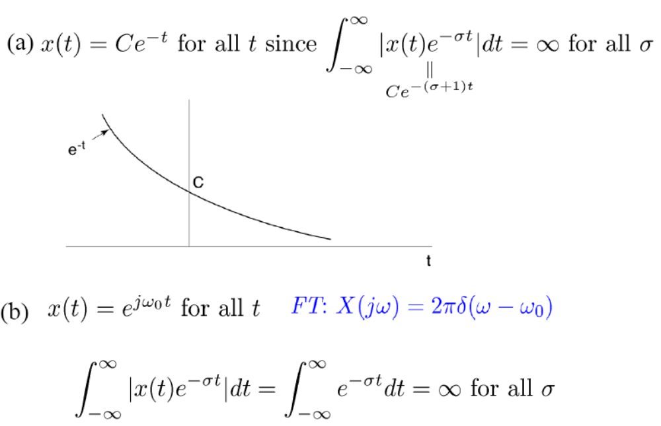
6.1.4 Laplace Transforms and RoCs
Some signals do not have Laplace Transforms (have no ROC)
X(s) is defined only in ROC; we do not allow impulses in LTs

Slide 13
Outline of the Chapter
6.1 (Bilateral) Laplace Transform
6.2 Properties of RoCs
6.3 Laplace Transform Properties
6.4 Inverse Laplace Transform
6.5 Analysis of LTI Systems using the LT
6.6 Unilateral Laplace Transform and Applications
W12.1

Slide 14
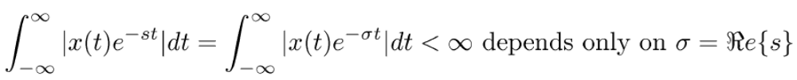
Properties of the ROC
The ROC can take on only a small number of different forms
1) The ROC consists of a collection of lines parallel to the jω-axis in the s-plane (i.e. the ROC only depends on σ).Why?
2) If X(s) is rational, then the ROC does not contain any poles. Why?
Poles are places where D(s) = 0
⇒ X(s) = N(s)/D(s) = ∞ Not convergent.

Slide 15
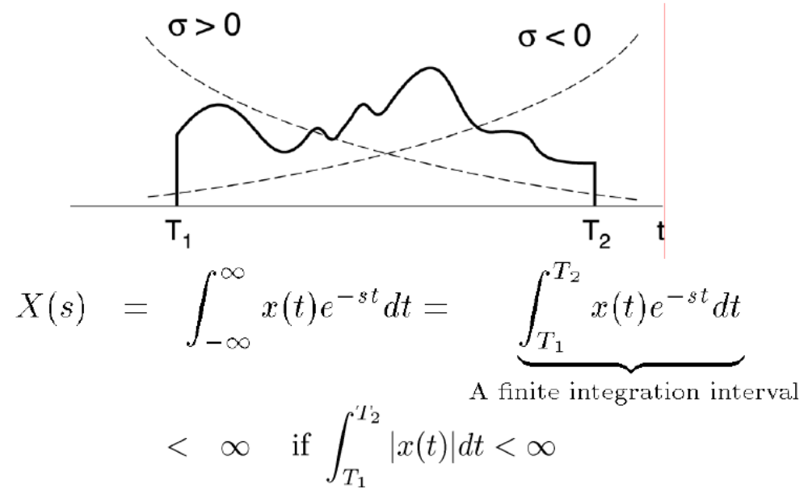
3) If x(t) is of finite duration and is absolutely integrable, then the ROC is the entire s-plane.

Slide 16
4) If x(t) is right-sided (i.e. if it is zero before some time), and if Re(s) = σ_{o} is in the ROC, then all values of s for which Re(s) > σ_{o} are also in the ROC.
ROC is a right half plane (RHP)
RoC depends on which side x(t) is on

Slide 17
5) If x(t) is left-sided (i.e. if it is zero after some time), and if Re(s) = σ_{o} is in the ROC, then all values of s for which Re(s) < σ_{o} are also in the ROC.
ROC is a left half plane (LHP)

Slide 18
6) If x(t) is two-sided and if the line Re(s) = σ_{o} is in the ROC, then the ROC consists of a strip in the s-plane that includes the line Re(s) = σ_{o}.

Slide 19

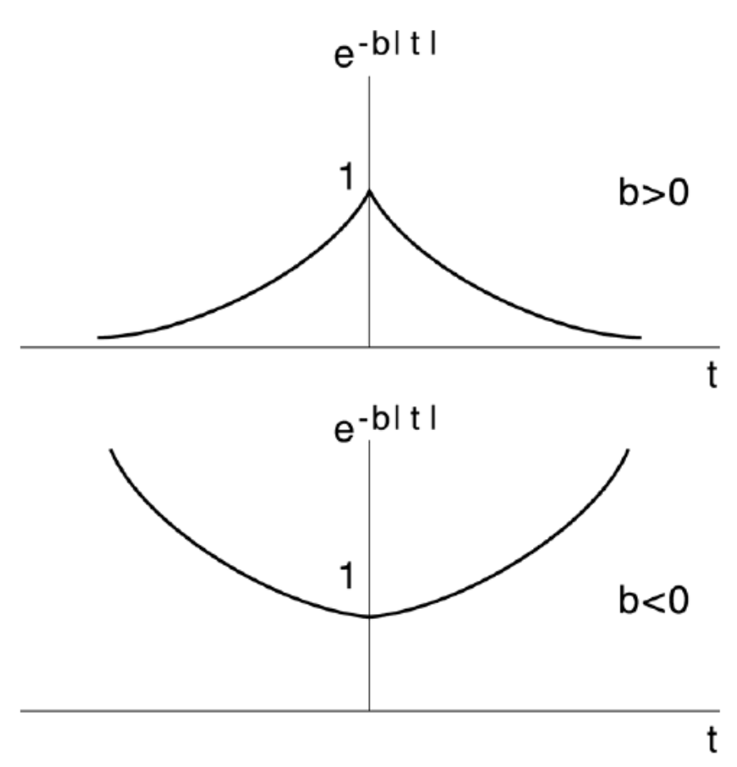
Example:
Intuition?
Okay: multiply by constant (e^{0t}) and will be integrable
Looks bad: no e^{σt} will dampen both sides

Slide 20
What if b < 0? ⇒No overlap ⇒ No Laplace Transform

Slide 21
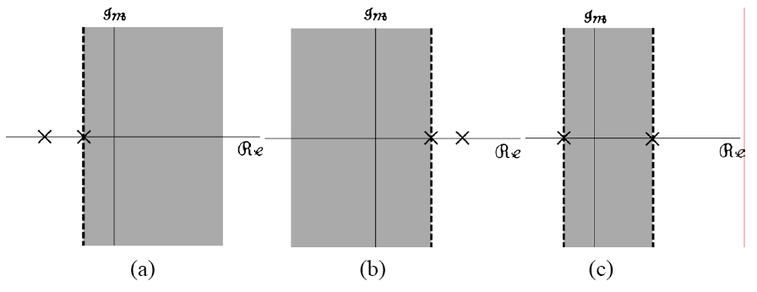
7) If X(s) is rational, then its ROC is bounded by poles or extends to infinity. In addition, no poles of X(s) are contained in the ROC.
8) Suppose X(s) is rational, then
(a) If x(t) is right-sided, the ROC is to the right of the rightmost pole.
(b) If x(t) is left-sided, the ROC is to the left of the leftmost pole.
9) If ROC of X(s) includes the jω-axis, then FT of x(t) exists.

Slide 22
Example:
Three possible ROCs
x(t) is right-sided ROC: III No
x(t) is left-sided ROC: I No
x(t) extends for all time ROC: II/Ф Yes/Unknown
Fourier Transform exists?

Slide 23
Outline of the Chapter
6.1 (Bilateral) Laplace Transform
6.2 Properties of RoCs
6.3 Laplace Transform Properties
6.4 Inverse Laplace Transform
6.5 Analysis of LTI Systems using the LT
6.6 Unilateral Laplace Transform and Applications

Slide 24
Many parallel properties of the CTFT, but for Laplace transforms we need to determine implications for the ROC
For example:
Linearity
ROC at least the intersection of ROCs of X₁(s) and X₂(s)
ROC can be bigger (due to pole-zero cancellation)

Slide 25
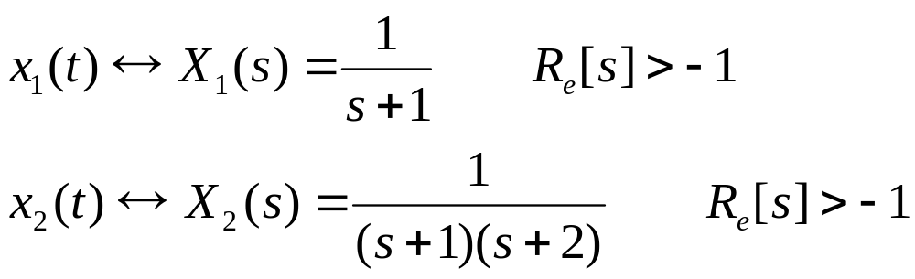
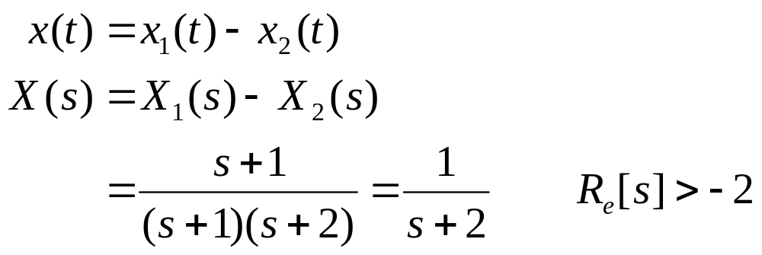
Example:
Note: the ROC can be bigger (due to pole-zero cancellation at s=-1)

Slide 26
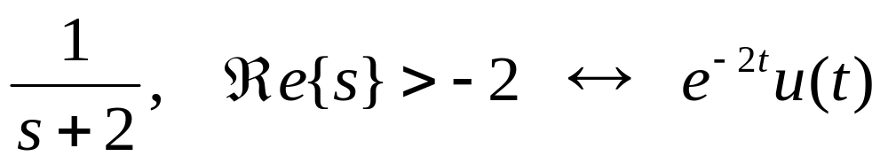
Time Shift

Slide 27
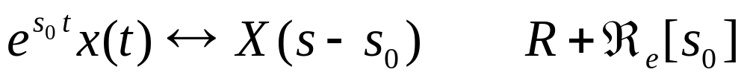
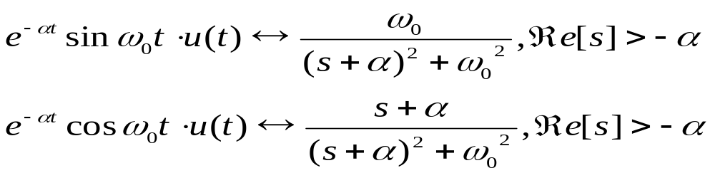
Shifting in the s-Domain
Example:

Slide 28
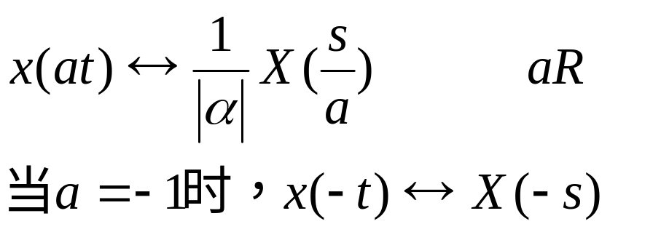

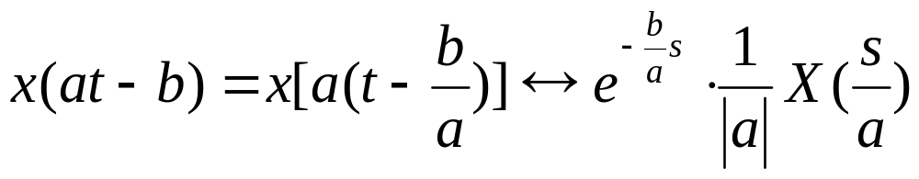
Time Scaling
Example:

Slide 29
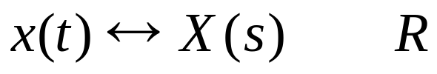
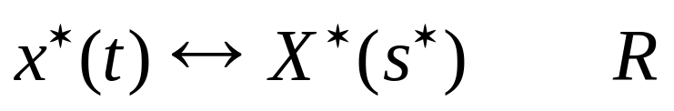
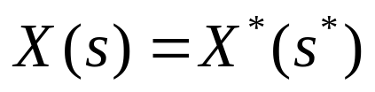
Conjugation
if x(t) is real valued

Slide 30
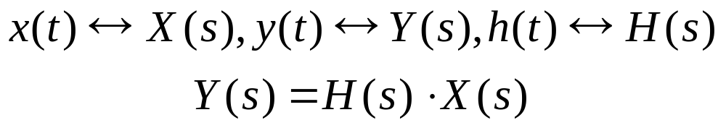

Convolution Property
x(t)
h(t)
y(t)=h(t)＊x(t)
For
Then
ROC of Y(s) = H(s)X(s): at least the overlap of the ROCs of H(s) & X(s)
ROC could be empty if there is no overlap between the two ROCs
E.g.
x(t)=e^{t}u(t),and h(t)=-e^{-tu}(-t)
ROC could be larger than the overlap of the two.

Slide 31
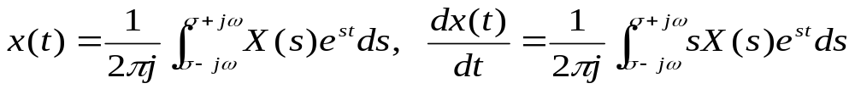

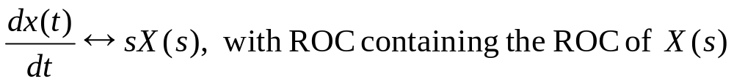
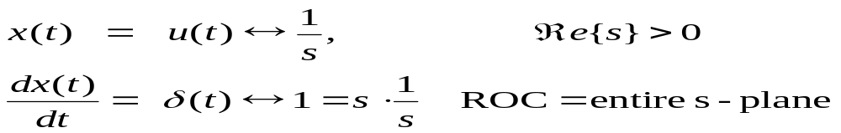
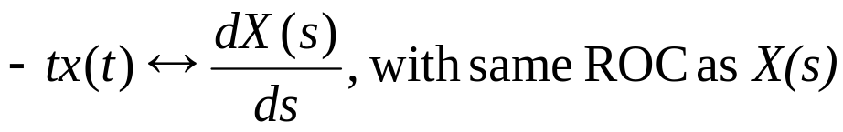
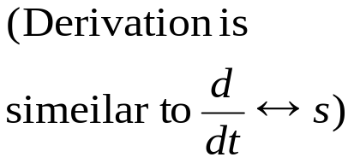
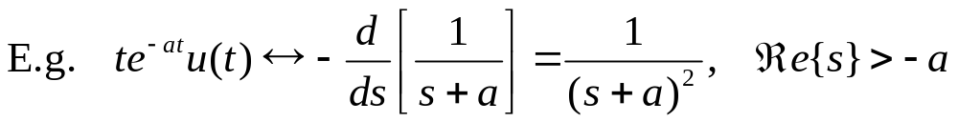
Time-Domain Differentiation
ROC could be bigger than the ROC of X(s), if there is pole-zero cancellation. E.g.,
s-Domain Differentiation

Slide 32
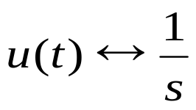
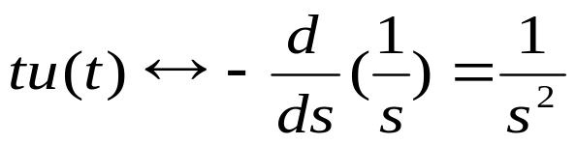
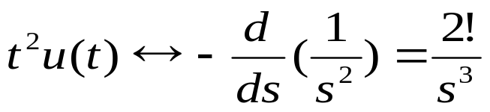

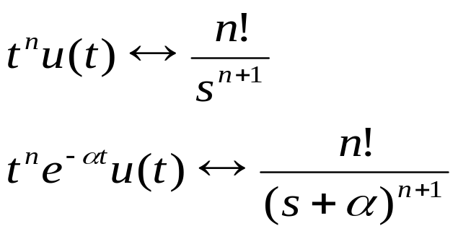
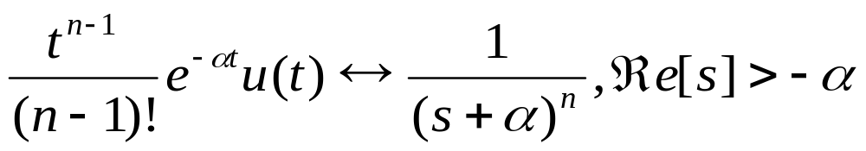
Example:

Slide 33
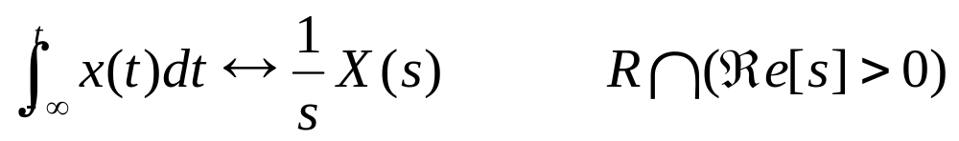
Integration in the Time Domain
at least
Using convolution property that the integration of x(t) is the output of x(t)*u(t)

Slide 34

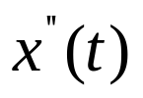








Example:
1
0
0
0

Slide 35
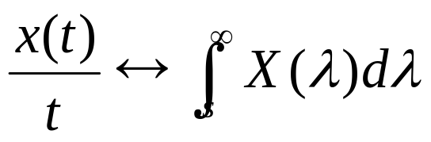
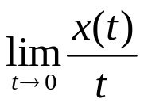
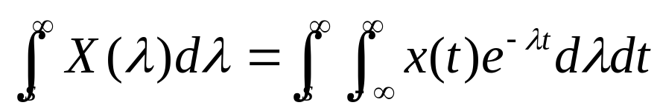
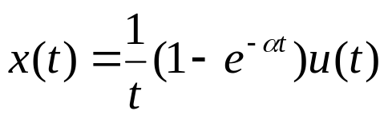
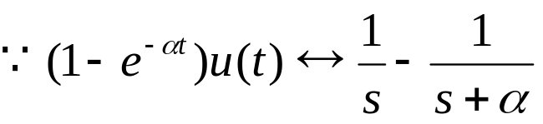
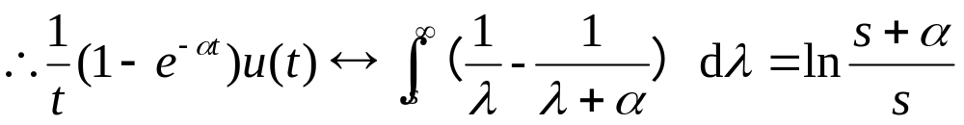
Integration in the S-Domain
(If x(t)=0 when t=0, and
exists)
Example:

Slide 36

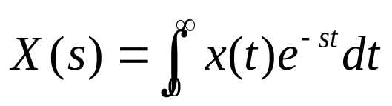
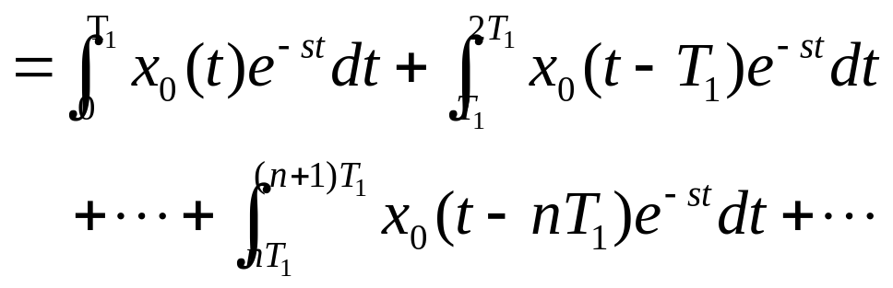
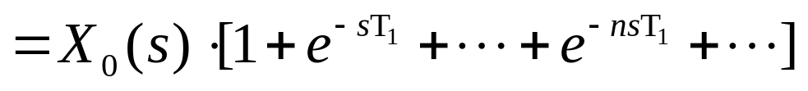
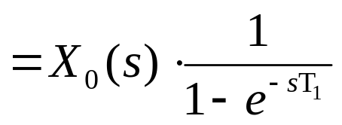
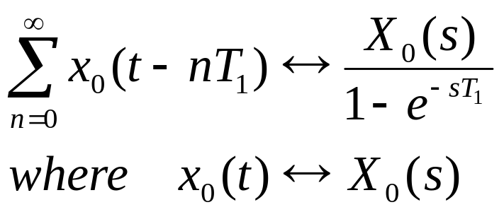
For signal
main signal valid from 0 to T

Slide 37





Sampling signal
then

Slide 38
Outline of the Chapter
6.1 (Bilateral) Laplace Transform
6.2 Properties of RoCs
6.3 Laplace Transform Properties
6.4 Inverse Laplace Transform
6.5 Analysis of LTI Systems using the LT
  6.6 Unilateral Laplace Transform and Applications
W13.1

Slide 39



6.4.1 The Inverse Fourier Transform
Consider
Then
-Inverse Laplace
Transform
Notes: we should choose any value of σ in the RoC to make the integration converged

Slide 40
The inverse Laplace transform equation states that x(t) can be represented as a weighted integral of complex exponentials
The formal evaluation of the integral for a general X(s) requires the use of contour integration (围线积分） in complex plane
For the class of rational transforms, the inverse Laplace tranform can be determined by using the technique of partial-fraction expansion.
√

Slide 41










①
—polynomial
Impulse function and its differentials (冲激函数及其各阶导数)
②
—strictly proper rational function (真分式)
where
are the zeros of
are the poles of

Slide 42
Recall

Slide 43




Suppose
(1)
: n poles are all distinct （n个极点都是单极点）

Slide 44

How to determine the constants k_{i}
To equating coefficients of equal power of s
(对应项系数平衡相等)
2.

Slide 45



Example:

Slide 46



solution1：
solution2：

Slide 47








For the varied ROC:
and

Slide 48




(2)
:
is the k-the order pole

Slide 49


How to determine the constants k_{i}
That is：

Slide 50



Example:

Slide 51




And
thus
If

Slide 52


(3)
has complex poles pair

Slide 53



Example:
If

Slide 54


Example:
Notes: by exploiting the properties of the Laplace transform
Let
then

Slide 55



where

Slide 56



To equating the coefficients of equal powers of s
Thus,

Slide 57


Example:
Notes:

Slide 58




Slide 59

Informative
Inverse Laplace Transform by means of Contour Integration

Slide 60


If z_{m} is the s-th order pole of
then

Slide 61


Slide 62
Outline of the Chapter
6.1 (Bilateral) Laplace Transform
6.2 Properties of RoCs
6.3 Laplace Transform Properties
6.4 Inverse Laplace Transform
6.5 Analysis of LTI Systems using the LT
  6.6 Unilateral Laplace Transform and Applications

Slide 63





6.5.1 CT System Function Properties
x(t)
h(t)
y(t)
H(s) = “system function”
1) System is stable ⬄ ⬄ROC of H(s) includes jω axis
2) Causality => h(t) right-sided signal => ROC of H(s) is a right-half plane
Question:
If the ROC of H(s) is a right-half plane, is the system causal?
E.x.
Non-causal

Slide 64
6.5.2 Properties of CT Rational System Functions
a) However, if H(s) is rational, then
The system is causal ⇔ The ROC of H(s) is to the right of the rightmost pole
b) If H(s) is rational and the system is a causal system, then
The system is stable ⇔ jω-axis is in ROC
⇔ all poles are in the left half plane

Slide 65





Example:
，its causality, stability, and calculate h(t)
There are 3 possible RoCs, i.e. 3 different systems
(1) If ROC is Re[s]>2
causal, unstable system
(2) If ROC is -3<Re[s]<2
Non-causal, stable system
(3) If ROC is Re[s]<-3
Non-causal, unstable system

Slide 66


Checking if All Poles Are In the Left-Half Plane
Poles are the root of D(s)=s^{n}+a_{n-1}s^{n-1}+…+a1s+a₀
Method #1: Calculate all the roots and see!
Method #2: Routh-Hurwitz – Without having to solve for roots.

Slide 67


6.5.3 Initial- and Final-Value Theorems
If x(t) = 0 for t < 0 and there are no impulses or higher order discontinuities at the origin, then
Initial value
If x(t) = 0 for t < 0 and x(t) has a finite limit as t → ∞, then
Final value

Slide 68



Proof of initial-value theorem:
(1)
(2)

Slide 69




Proof of initial-value theorem:

Slide 70



Proof of final-value theorem:
(1)
(2)

Slide 71



Applications of the Initial- and Final-Value Theorem
For
n-order of polynomial N(s), d – order of polynomial D(s)
• Initial value：
• Final value：

Slide 72

Example:
Suppose we have the following information about an LTI system:
(1) The system is casual,
(2) The system function is rational and have only two poles at s=-2,s=4
(3) If x(t)=1, then y(t)=0
(4) The value of impulse response at t=0⁺ is 4, i.e.
To determine the system function of the system H(s)
Solution:
From the first 2 facts, we know that the ROC of the system is drawn in the right figure.
The system is causal and unstable

Slide 73





As H(s) is rational, we have the system function of the following form
From fact 3,
We conclude that
∴H(s) must have a zero at s=0, i.e. p(s)=s·q(s)
Finally, from fact 4 and initial-value theorem, we obtain that

Slide 74




As s→∞,
If the numerator has higher degree than the denominator, the limit will diverge
If the numerator has lower degree than the denominator,
A none-zero limit exists only when they have the same degree!
i.e.
Thus:

Slide 75



6.5.4 LTI Systems Described by LCCDEs
roots of numerator ⇒ zeros
roots of denominator ⇒ poles
ROC =? Depends on: 1) Locations of all poles.
2) Boundary conditions, i.e.
right-, left-, two-sided signals.

Slide 76


System Function Algebra
Example: A basic feedback system consisting of causal blocks
More on this later in feedback
ROC: Determined by the roots of 1+H₁(s)H₂(s), instead of H₁(s)

Slide 77






Block Diagram for Causal LTI Systems with Rational System Functions
Example：
— Can be viewed as cascade of two systems.

Slide 78



Instead of
We can construct H(s) using:
Notation: 1/s—an integrator

Slide 79


Note also that
Lesson to be learned：There are many different ways to construct a system that performs a certain function.

Slide 80




Example2:
For an LTI system, when the input
the zero-state response of the system is
To determine the system function H(s) and its corresponding differential equation

Slide 81




Example:
For an LTI system with the same initial conditions,
With the input
, the full system response
With the input
, the full system response
To determine the system impulse response h(t) and its differential equation.
Notes: Full response = zero-input response + zero-state response

Slide 82





Being

Slide 83




Example:
For an LTI system with zero initial conditions, i.e. initial rest
  1. when
,
  2. For all t,
, y(t)=0
To determine:
Coefficient a and the differential equation of the system.
The system response to the input

Slide 84



（a）
(1)
and
So H(-2)=0,
Substituting it in (1) , one obtains a=7/4

Slide 85



（b）as initial rest

Slide 86





6.5.5 System Functions of Typical Systems
Example 1: A first-order pole
Still reason with vector, but remember to "invert" for poles
Example 2: A higher-order rational Laplace transform

Slide 87







First-Order System
Graphical evaluation of H(jω)

Slide 88


Bode Plot of the First-Order System

Slide 89





Second-Order System
complex poles
— Underdamped
double pole at s = −ω_{n}
— Critically damped
2 poles on negative real axis
— Overdamped

Slide 90

Bode Plot of a Second-Order System
Top is flat when
ζ= 1/√2 = 0.707
⇒a LPF for
ω < ω_{n}

Slide 91

Unit-Impulse and Unit-Step Response of a Second- Order System
No oscillations when
ζ ≥ 1
⇒ Critically (=) and over (>) damped.

Slide 92





First-Order All-Pass System
Two vectors have the same lengths

Slide 93
Outline of the Chapter
6.1 (Bilateral) Laplace Transform
6.2 Properties of RoCs
6.3 Laplace Transform Properties
6.4 Inverse Laplace Transform
6.5 Analysis of LTI Systems using the LT
6.6 Unilateral Laplace Transform and Applications

Slide 94




The Unilateral Laplace Transform
(The preferred tool to analyze causal CT systems described by LCCDEs with initial conditions)
Note:
If x(t) = 0 for t < 0,
Unilateral LT of x(t) = Bilateral LT of x(t)u(t-)
For example, if h(t) is the impulse response of a causal LTI system then,
Convolution property: If x₁(t) = x₂(t) = 0 for t < 0,
Same as Bilateral Laplace transform

Slide 95





Differentiation Property for Unilateral Laplace Transform
Initial condition!
integration by parts
∫f．dg=fg－∫g．df
Derivation：
Note：

Slide 96



Use of ULTs to Solve Differentiation Equations with Initial Conditions
For an LTI system represented by LCCDE
With initial conditions:
The input x(t) satisfies: when t<0, x(t)=0
then

Slide 97





A(s)
M(s)
B(s)
  ZIR — Response for zero input x(t)=0
ZSR — Response for zero state, initially at rest

Slide 98



Example:
with x(t)=u(t)
To determine
i.e.
(1)

Slide 99




Substituting , and in (1)

Slide 100
Homework (Due W16-D2)
  BASIC PROBLEMS: 9.21, 9.22, 9.31, 9.32, 9.37

Slide 101
Outline of the Chapter
6.1 (Bilateral) Laplace Transform
6.2 Properties of RoCs
6.3 Laplace Transform Properties
6.4 Inverse Laplace Transform
6.5 Analysis of LTI Systems using the LT
6.6 Unilateral Laplace Transform and Applications

Slide 102

A Typical Feedback System
  Why use Feedback?
Reducing Effects of Nonidealities
Reducing Sensitivity to Uncertainties and Variability
Stabilizing Unstable Systems
Reducing Effects of Disturbances
Tracking
Shaping System Response Characteristics (bandwidth/speed)

Slide 103

One Motivating Example
Open-Loop System Closed-Loop Feedback System

Slide 104



Analysis of (Causal!) LTI Feedback Systems: Black’s Formula
CT System
Black’s formula (1920’s)
  Closed - loop system function
  Forward gain — total gain along the forward path from the input to the output
  Loop gain — total gain around the closed loop

Slide 105




Applications of Black’s Formula
Example:
1)
2)

Slide 106



The Use of Feedback to Compensate for Nonidealities
Assume KP(jω) is very large over the frequency range of interest. In fact, assume
— Independent of P(s)!!

Slide 107


Example of Reduced Sensitivity
1)The use of operational amplifiers
2)Decreasing amplifier gain sensitivity
Example:
(a) Suppose
(b) Suppose

Slide 108


Fine, but why doesn’t G(jω) fluctuate ?
Note:
For amplification, G(jω) must attenuate, and it is much easier to build attenuators (e.g. resistors) with desired characteristics
There is a price:
Needs a large loop gain to produce a steady (and linear) gain for the whole system.
⇒ Consequence of the negative (degenerative) feedback.

Slide 109


Example: Operational Amplifiers
If the amplitude of the loop gain
  |KG(s)| >> 1 — usually the case, unless the battery is totally dead.
Then Steady State
The closed-loop gain only depends on the passive components
(R₁ & R₂), independent of the gain of the open-loop amplifier K.

Slide 110

The Same Idea Works for the Compensation for Nonlinearities
Example and Demo:
Amplifier with a Deadzone
The second system in the forward path has a nonlinear input-output relation (a deadzone for small input), which will cause distortion if it is used as an amplifier. However, as long as the amplitude of the “loop gain” is large enough, the input-output response ≅ 1/K₂

Slide 111




Improving the Dynamics of Systems
Example: Operational Amplifier 741
The open-loop gain has a very large value at dc but very limited bandwidth
Not very useful on its own
With feedback
───Much broader bandwidth, also

Slide 112


Stabilization of Unstable Systems
P(s) — unstable
Design C(s), G(s) so that the closed-loop system
is stable
⇒ poles of Q(s) = roots of 1+C(s)P(s)G(s) in LHP

Slide 113




Example #1: First-order unstable systems
Try： proportional feedback
Stable as long as K>2

Slide 114



Example #2: Second-order unstable systems
Attempt #1：Proportional Feedback C(s)=K
— Unstable for all values of K
— Physically, need damping — a term proportional to s ⇔ d/dt

Slide 115



Example #2 (continued):
Attempt #2: Try Proportional-Plus-Derivative (PD) Feedback
— Stable as long as K₂ > 0 (sufficient damping)
  and K₁ > 4 (sufficient gain).

Slide 116

Example #2 (one more time):
Why didn’t we stabilize by canceling the unstable poles?
There are at least two reasons why this is a really bad idea:
  a) In real physical systems, we can never know the precise values of the poles, it could be 2±∆.
b) Disturbance between the two systems will cause instability.

Slide 117



Demo: Magnetic Levitation
i_{o} = current needed to balance the weight W at the rest height y_{o}
Force balance
Linearize about equilibrium with specific values for parameters
─── Second-order unstable system

Slide 118




Magnetic Levitation (Continued):
—Stable!

Slide 119


The Concept of a Root Locus
C(s),G(s) — Designed with one or more free parameters
Question: How do the closed-loop poles move as we vary these parameters? — Root locus of 1+ C(s)G(s)H(s)

Slide 120

The “Classical” Root Locus Problem
  C(s) = K— a simple linear amplifier

Slide 121




A Simple Example
  In either case, pole is at s_{o} = -2 - K
  Sketch where pole moves
as |K| increases...
Becomes more stable Becomes less stable

Slide 122



What Happens More Generally ?
For simplicity, suppose there is no pole-zero cancellation in G(s)H(s)
Closed-loop poles are the solutions of
That is
— Difficult to solve explicitly for solutions given any specific value of K, unless G(s)H(s) is second-order or lower.
— Much easier to plot the root locus, the values of s that are solutions for some value of K, because:
1) It is easier to find the roots in the limiting cases for K = 0, ±∞.
2) There are rules on how to connect between these limiting points.

Slide 123
Rules for Plotting Root Locus
End points
  — At K = 0, G(s_{o})H(s_{o}) = ∞
  ⇒ s_{o} are poles of the open-loop system function G(s)H(s).
  — At |K| = ∞, G(s_{o})H(s_{o}) = 0
  ⇒s_{o} are zeros of the open-loop system function G(s)H(s). Thus:
  Rule #1:
  A root locus starts (at K = 0) from a pole of G(s)H(s) and ends (at
|K| = ∞) at a zero of G(s)H(s).
Question: What if the number of poles ≠ the number of zeros? Answer: Start or end at ±∞.

Slide 124

Rule #2: Angle criterion of the root locus
Thus, s₀ is a pole for some positive value of K if:
In this case, s₀ is a pole if K = 1/|G(s₀) H(s₀)|.
Similarly s₀ is a pole for some negative value of K if:
In this case, s₀ is a pole if K = -1/|G(s₀) H(s₀)|.

Slide 125



Example of Root Locus.
One zero at -2, two poles at 0, -1.

Slide 126



Tracking
In addition to stability, we may want good tracking behavior, i.e.
for at least some set of input signals.
We want C(jω)P(jω) to be large in frequency bands in which we want good tracking

Slide 127
Tracking (continued)
Using the final-value theorem
Basic example: Tracking error for a step input

Slide 128

Disturbance Rejection
There may be other objectives in feedback controls due to unavoidable disturbances.
Clearly, sensitivities to the disturbances D₁(s) and D₂(s) are much reduced when the amplitude of the loop gain

Slide 129


Internal Instabilities Due to Pole-Zero Cancellation
However

Slide 130



Inverted Pendulum
m=Mass, I=moment of inertia
──Unstable！

Slide 131

Feedback System to Stabilize the Pendulum
PI feedback stabilizes θ
Subtle problem: internal instability in x(t)!
  –Additional PD feedback around motor / amplifier centers the pendulum

Slide 132




Root Locus & the Inverted Pendulum
Attempt #1: Negative feedback driving the motor
Root locus of M(s)G(s)
– Remains unstable!
after K. Lundberg

Slide 133



Root Locus & the Inverted Pendulum
Attempt #2: Proportional/Integral Compensator
Root locus of K(s)M(s)G(s)
– Stable for large enough K
after K. Lundberg

Slide 134



Root Locus & the Inverted Pendulum
BUT – x(t) unstable:
System subject to drift...
  Solution: add PD feedback around motor and compensator:
after K. Lundberg

